Slide 1


Disney: Mouse to Momentous
Anthony Meunier
DeVry University

Slide 2
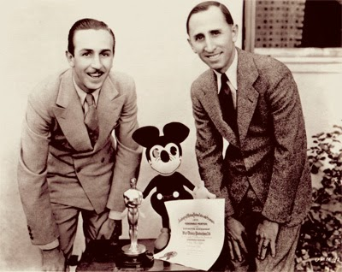
Disney had humble beginnings but has quickly grown into a multifaceted entertainment empire.
1923: Inception
1946: Live Action & Television
1955: Disneyland
1989: Commercial and critical success
1995–present: Acquisition of ABC family of networks; new business opportunities

Slide 3
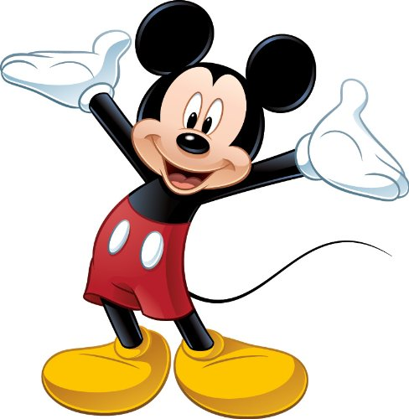
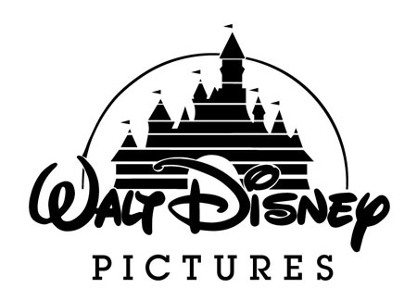

Disney’s iconic and timeless creations have helped shape the company into the conglomerate it is today.
Mickey Mouse
Snow White
Theme Parks
Hotels & Resorts
“Disney Vault”
Disney Store
Disney Channel
Motion Pictures
Video Games & Web

Slide 4
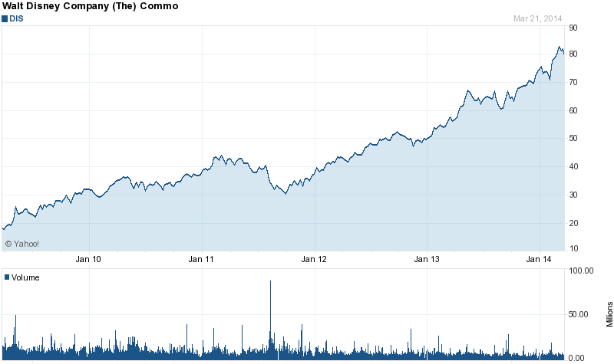
Disney is synonymous with success, and this translates into the world of stocks.

Slide 5
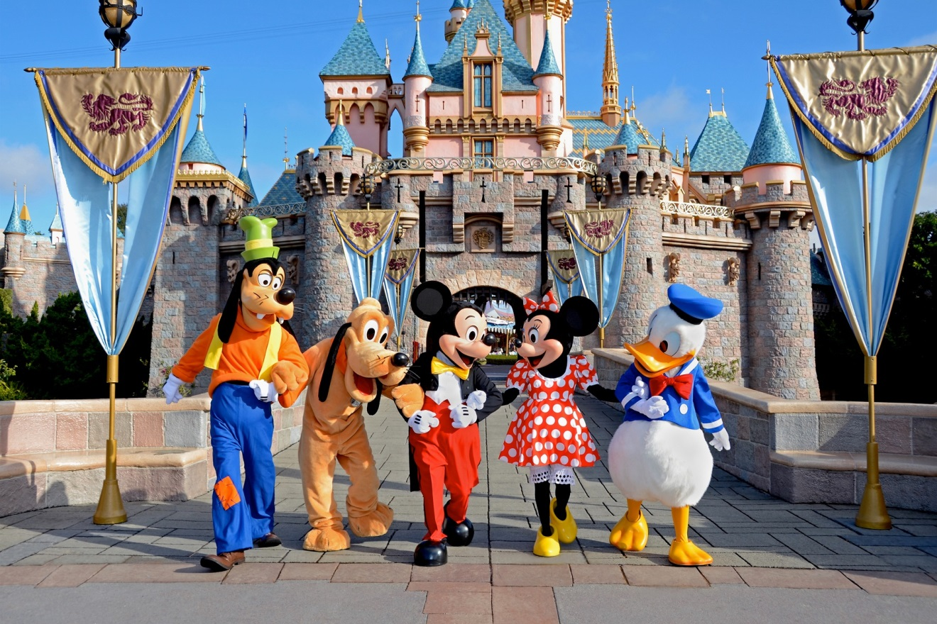
“Here you leave today and enter the world of yesterday, tomorrow, and fantasy.” - Walt Disney

